Slide 1

Low-Cost Uncrewed Lunar Landers: Mission Design and Feasibility Assessment
Final Presentation
Conall DE PAOR – MAE 2

Slide 2

INTRODUCTION
CONTENTS
Context
Project Objectives
Methods
Results
Conclusions

Slide 3
CONTEXT Last Year’s Work
Last year’s objective:
create a fast-prototyping tool create a fast-prototyping tool to size and optimize power, mass and data budgets of planetary exploration systems
Built a database of rovers and lunar landers and derived mass estimation relationships. Applied to a case study.
After attending SSDW. Interest moved to system sizing and costing of lunar transport mission architectures.
Notes:
Skip over last years work.

Slide 4
RESEARCH OBJECTIVES
1. Extend the lander database and sizing rules
2. Investigate the costs of lunar cargo transport

Slide 5
CONTEXT Cost of Spaceflight
Other Program Costs per FM
Apollo: $31.7 B
ISS: $150 B
ATV: $409 M
Telespazio LCL: $182 M
Agency Budgets 2022
NASA: $24.4 B
ESA: $4.81 B
Notes:
Brush over the figures. Say the range.

Slide 6
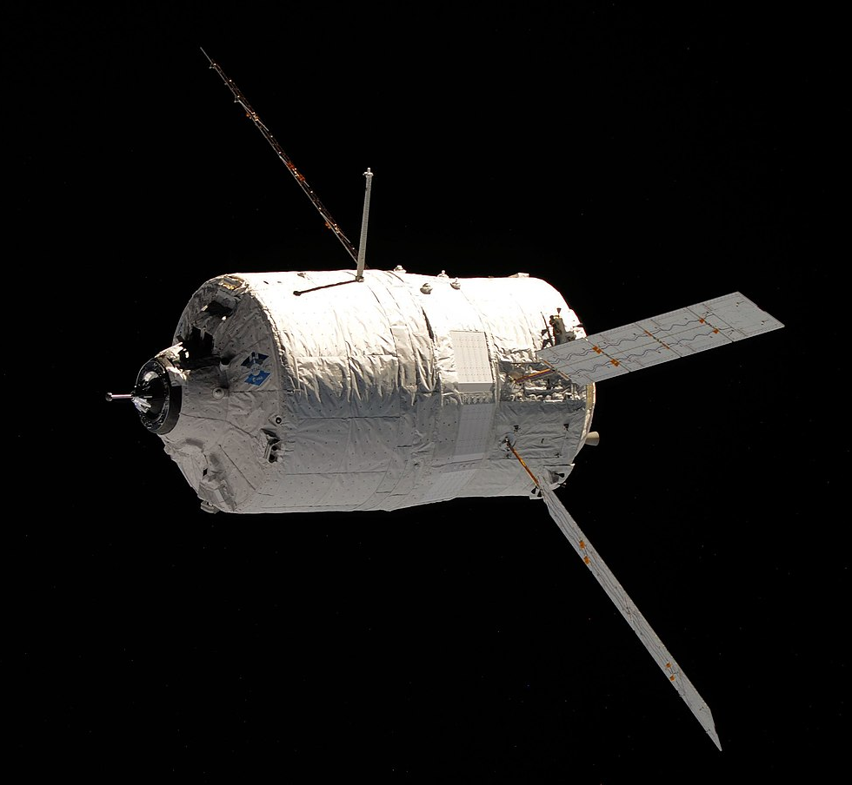
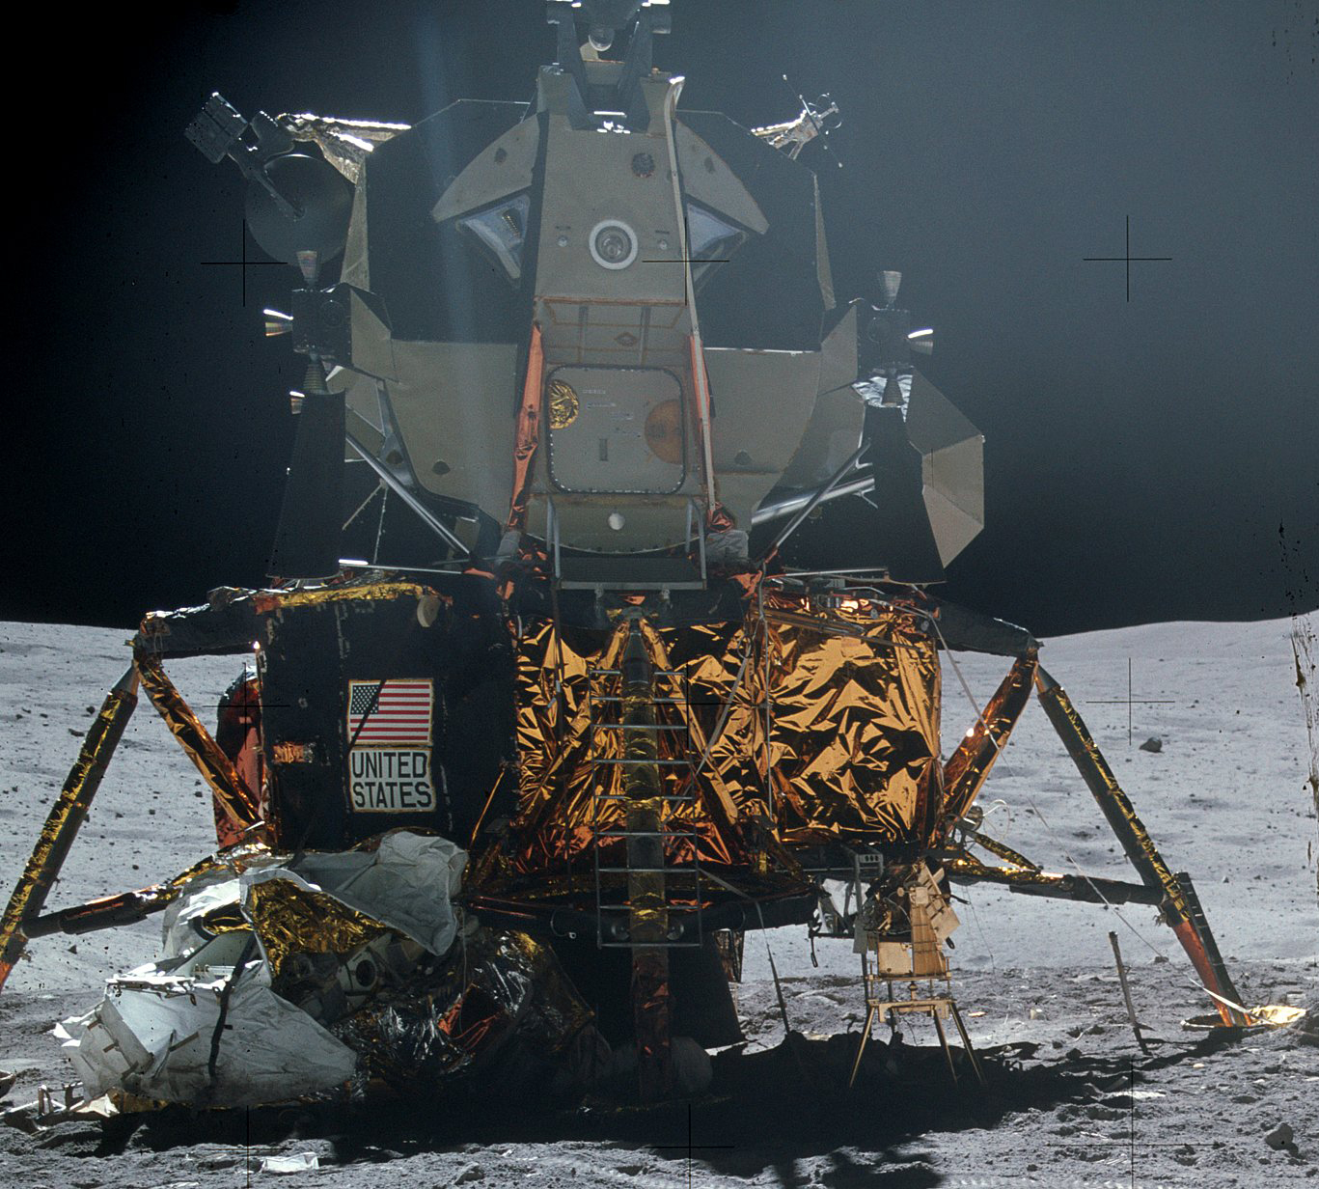
CONTEXT Space Cargo Transport
Cargo to ISS
2.4t - 7.6t delivered per launch
Specific cargo delivery cost (not price)
14,500 $/kg (Progress)
40,000 $/kg (Dragon 1)
80,000 $/kg (ATV)
Payload to the Lunar Surface
Apollo Ascent stage 4.8t
6.6 M $/kg
Return of Lunar regolith 382kg
82.9 M $/kg
Cost of Earth Diamonds: 12 M $/kg
Notes:
Brush over Cargo to the ISS

Slide 7
METHODS Mission Architectures
To investigate the costs of lunar transport, we have to look at the whole trade space of mission architectures for lunar transport.
Mission Statement:
To transport payloads to the lunar surface from the Earth’s surface and back again in a cost-effective manner.
Timeframe: Development start 2023, Operation start 2033, End 2047

Slide 8
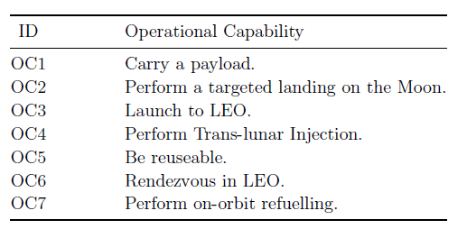
METHODS 5 Mission Architectures
Functional analysis reveals necessary operational capabilities:
Added constraint that down_payload = up_payload
Assumed an orbital fuel depot at LOP-G. No fuel on the surface

Slide 9
MA 5. The Old Fashioned Way
M
P
L
Legend
P = payload
TLV = transfer vehicle
= Lander
P
P
TV
LLO
L
P
L
2.5 km/s
TV
LGO
3.8 km/s
LEO
TV
P
L
🚀
E
1
2
3
4
Launch
Separation
TLI + Landing
deployment
Mission Architecture Phases

Slide 10
MA 1. 1-Stage-Transfer
M
P₁
P₂
TLV
Legend
= payload
= transfer and landing vehicle
P_{i}
TLV
LLO
P₁
TLV
2.5 km/s
TLV
P₂
LOP-G
3.8 km/s
LEO
TLV
P₁
TLV
P₂
🚀
E
1
2
3
4
5
6
Launch
RDV +
fuelling
TLI + Landing
deployment
Take-off + TEI
Circularise
+ Loiter
Mission Architecture Phases

Slide 11
MA 2. 2-Stage-Transfer
M
P₁
L
P₂
Legend
P = payload
TV = transfer vehicle
L = Lander
P_{i}
P₁
P₂
TV
LLO
L
L
L
2.5 km/s
LOP-G
TV
P₁
TV
TV
P₂
L
L
P₁
3.8 km/s
TV
TV
P₂
TV
LEO
TV
P₁
P₂
🚀
E
1
2
3
4
5
6
7
8
9
10
Launch
RDV+ fuelling
TLI
RDV+ fuelling
Landing
Deployment
Take-off
RDV+
fuelling
TEI
Circularise
+ Loiter
Mission Architecture Phases

Slide 12
MA 3. 3-Stage-Transfer
M
P₁
L
P₂
Legend
P = payload
= Transfer vehicle 1
= Transfer vehicle 2 L = lander
1.9 km/s
L
P_{i}
P₂
TV1
LLO
TV2
P₁
L
TV2
L
P₂
TV2
TV2
P₁
L
0.64 km/s
TV2
TV2
P₂
LGO
TV1
P₁
TV2
TV1
TV2
P₂
TV1
P₁
P
3.8 km/s
TV1
TV1
TV1
P₂
TV1
LEO
P₁
P₂
P
🚀
E
1
2
3
4
5
6
7
8
9
10
11
12
Launch
RDV fuelling
TLI
RDV fuelling
LLO transfer
RDV fuelling
Landing deployment Lift-off
LGO transfer
RDV
TEI
Circularise
+ Loiter
RDV
Mission Architecture Phases

Slide 13
MA 4. 2-Stage-Electric-Transfer
M
P₁
L
P₂
Legend
P = payload
ETV = electric transfer vehicle
L = Lander
P_{i}
P
P₁
TV1
L
L
L
LLO
P₂
2.5 km/s
LGO
ETV
P₁
ETV
L
P₂
ETV
L
P₁
3.8 km/s
ETV
ETV
ETV
P₂
ETV
P₂
LEO
P₁
🚀
E
1
2
3
4
5
6
7
8
9
10
Launch
RDV fuelling
TLI
RDV fuelling
Landing
Deploy
Lift-off
RDV Loiter
TEI
Circularise
+ Loiter
Mission Architecture Phases

Slide 14
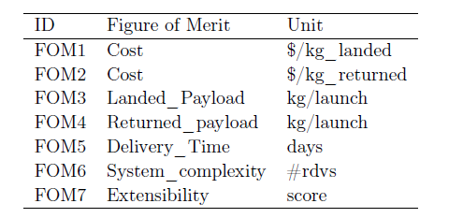
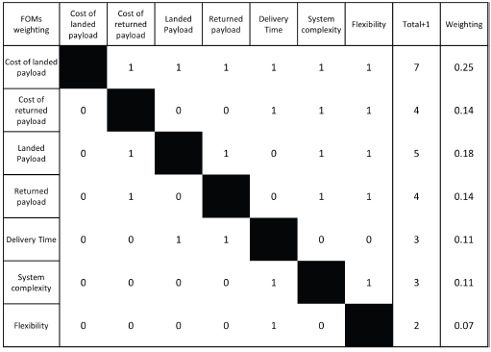
METHODS Trade Study
Figures of Merit
Pairwise comparison
5 MAs had their FOMs evaluated,
FOMs are normalised and multiplied by their weighting to to pick the winner
The winning MA is investigated in more detail.

Slide 15
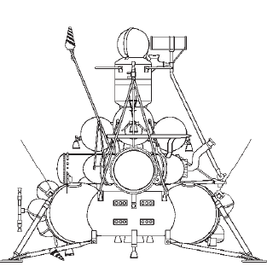
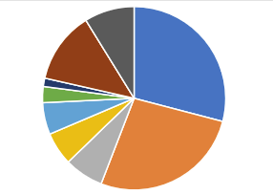
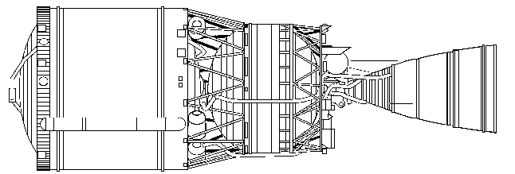
METHODS Spacecraft Sizing
Lunar Landers (41)
Total mass
Dry mass
Propellant mass
Payload mass
Propellant
Isp
ΔV
Transfer Vehicles (8)
Total mass
Dry mass
Propellant mass
Payload mass
Propellant
ΔV
Characteristic Energy
Lander Subsystems (11)
Dry mass
Structure
Power
Propulsion
Avionics
Thermal

Slide 16
METHODS Lander Sizing
Start by imposing 2t lunar payload down and payload up for the lander.
α

Slide 17
METHODS Transfer Vehicle Sizing

Slide 18
METHODS Subsystem Sizing
Landers Subsystems are sized using Mass estimation relationships derived from trend analysis of the database.
Power subsystem sized parametrically, using LRO as a benchmark.
Modern Avionics are oversized this way. Adjusted to 3.1%.

Slide 19
METHODS Cost Estimation
$$Life Cycle Cost=DDTE+Construction+Operation+Disposal$$
DDTE:
Development cost of spacecraft
Construction:
Launch Costs of placing spacecraft in orbit + production cost of spacecraft
Operation:
Launch costs of payload and fuel + ground support costs
Disposal:
= one delivery cycle cost

Slide 20
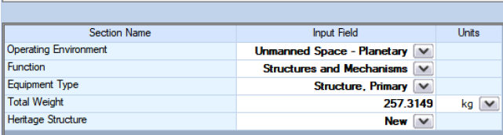
METHODS TruePlanning
Costs estimated using TruePlanning Cost engineering tool
Development costs from a subsystem mass breakdown and information on the nature of the subsystem.
Assumed 3 flight models of Lander completing 60 trips in 15 years

Slide 21


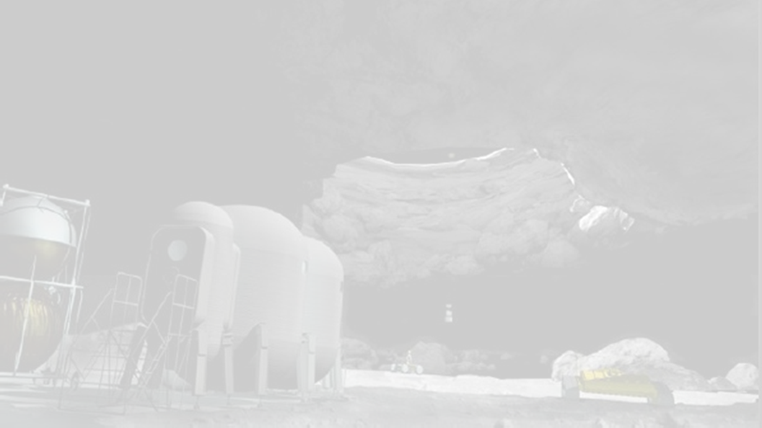
RESEARCH WORK TO BE TACKLED IN THE FOLLOWING MONTHS
RESULTS

Slide 22
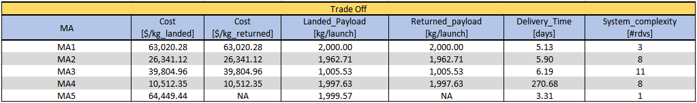
RESULTS Trade Study
2-stage Transfer is the winner
Low cost and quick delivery time

Slide 23
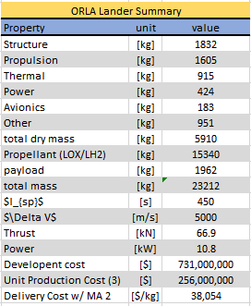
RESULTS Lander Design
Lander needs a name: ORLA
Total mass: 23.2t
Dry mass: 5.9t
Payload 2t
Unit Production Cost (3): $256M

Slide 24
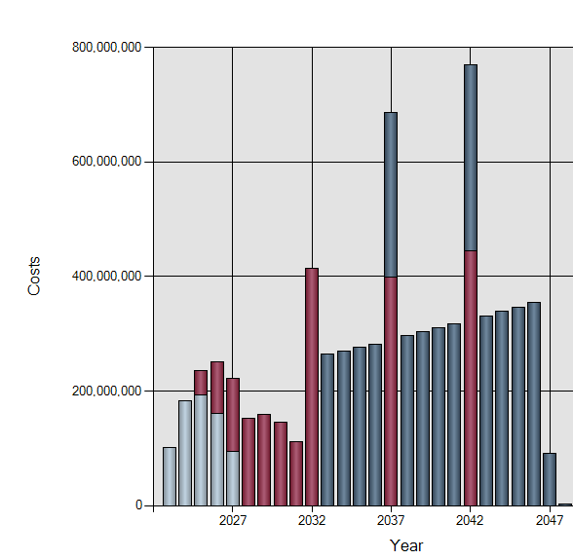
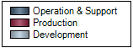
RESULTS Mission Costs
Life Cycle Cost: $7.2B
DDTE: $731M
Construction: $1.88B
Operation: $4.4B
Disposal: $73M
Specific delivery costs
$30,000/kg
Costs of one delivery
$38M

Slide 25
CONCLUSIONS
Payload delivery and return an order of magnitude cheaper if orbital refuelling and reusable systems are used
The main cost drivers of lunar cargo delivery are:
Initial construction launch costs
Fuel carriage
An orbital fuel station at LOP-G would have to be large (20-30t)

Slide 26
FUTURE WORK
Analyse impact of trajectory optimisation on specific cost
Include development costs of on-orbit refuelling
Automate the sizing procedure to enable more sophisticated iterative sizing methods and optimisation

Slide 27
RESEARCH WORK TO BE TACKLED IN THE FOLLOWING MONTHS
Questions?
Notes:
GATHER SIZING RULES FOR MASS POWER AND DATA BUDGET OF PLANETARY EXPLORATION SYSTEMS
PERFORM TRADE-OFF ANALYSIS
IMPLEMENT THE SIZING RULES ON THE LAVA TUBES MISSION
WRITE 2 IAC PAPERS
APPLICATION TO HUMANS?

Slide 28
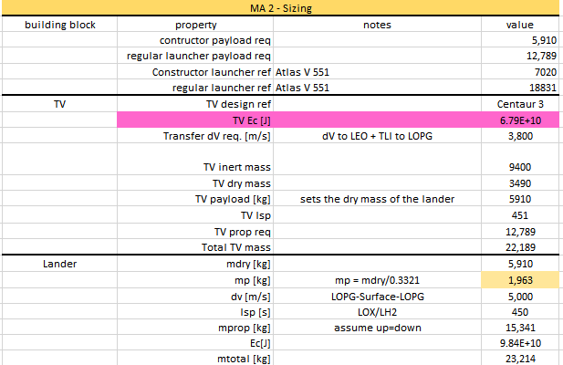
APPENDIX A

Slide 29
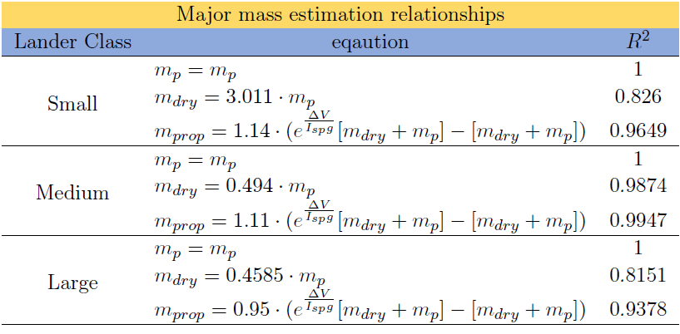
APPENDIX B Lander Sizing Rules
m_{p} < 2t
2 < m_{p} < 5t
5t < m_{p}

